Slide 1

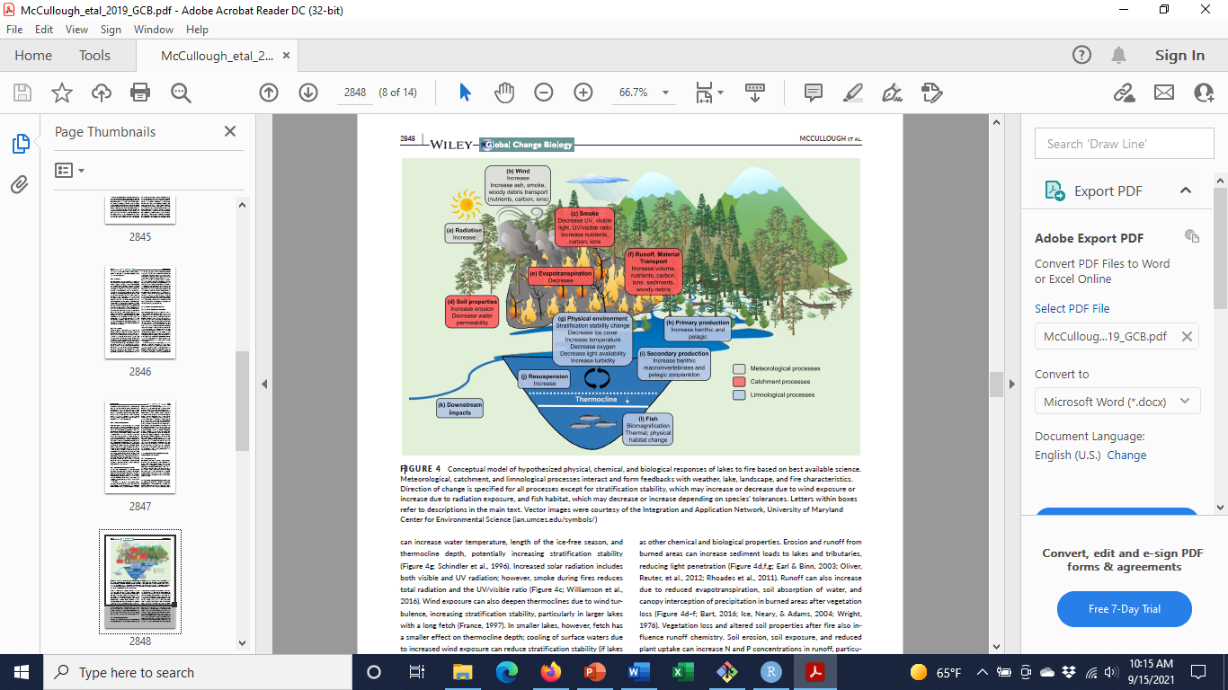
Jem
Highlights
Fire increasing in lake watersheds
We have some idea how lakes respond to fire
But, most studies:
Few lakes
Few years
High latitude/boreal
Need more studies across more ecologically diverse lakes, landscapes, fire regimes

Slide 2
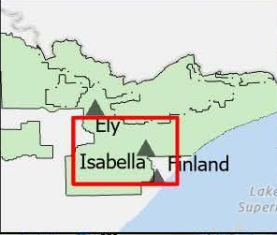
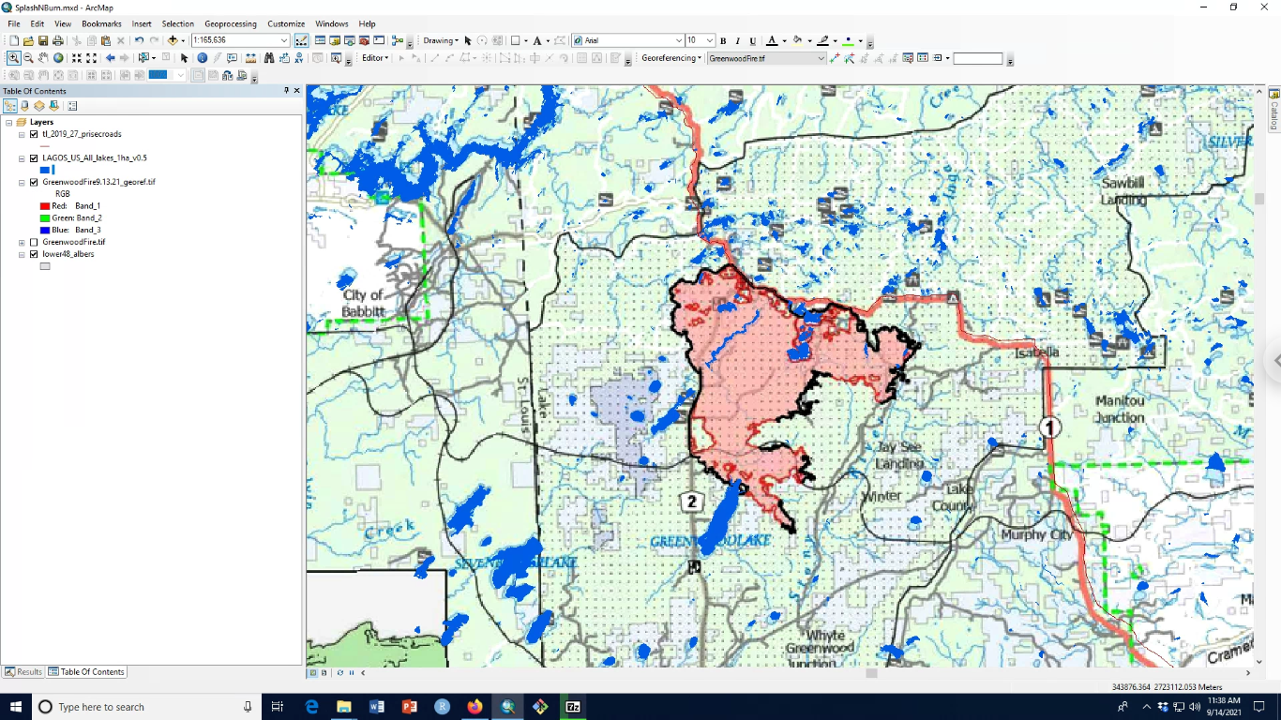
Meanwhile, in the Midwest
Greenwood Fire
As of 9-15-21
~ 27000 acres/10000 ha
75% contained
Thought to be lightning caused ~ 8-15-21
https://inciweb.nwcg.gov/incident/map/7805/0/125373

Slide 3
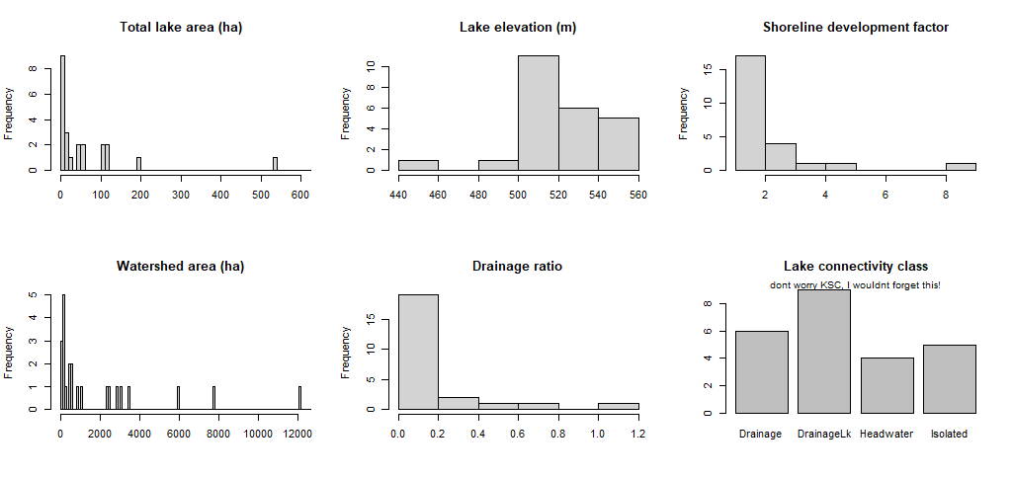
Burned lake characteristics (from LAGOS-US-LOCUS)
One very large 3136 ha lake not shown
One very large 44552 ha ws not shown

Slide 4
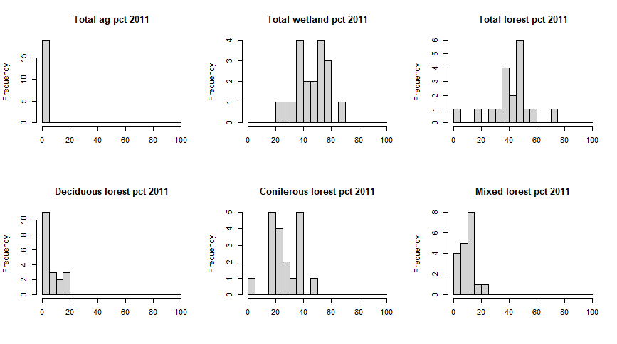
Burned watersheds are mix of wetlands and forest, primarily coniferous (from LAGOSNE)
(19 of 24 lakes > 4ha)

Slide 5
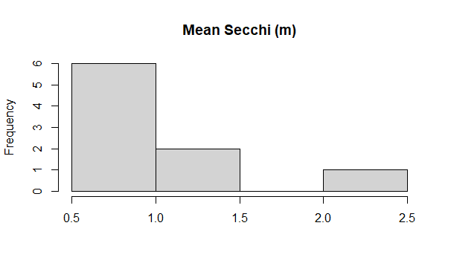
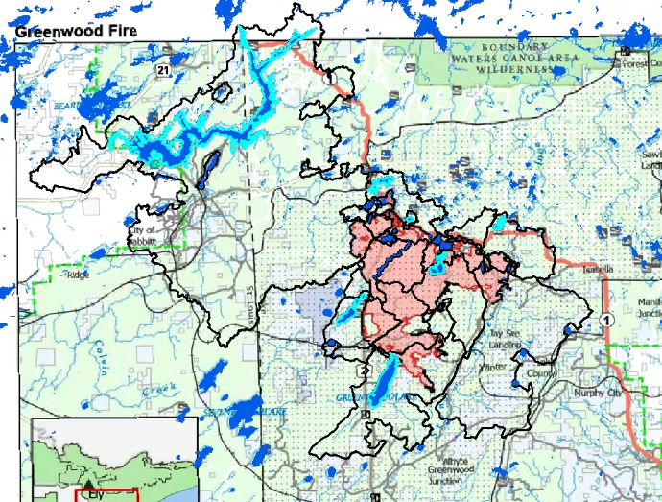
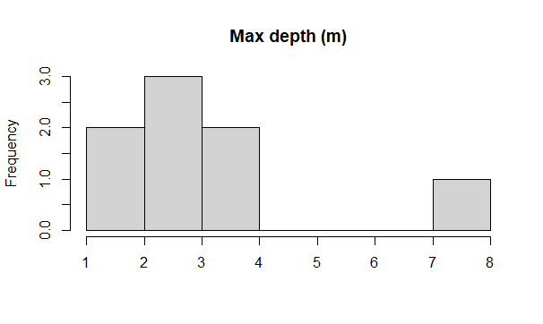
Limno data (LAGOSNE) are limited:
9 lakes, 8 of which only have Secchi (1-35 samples per lake)
8 of which have max depth (LAGOS-US-DEPTH)
Birch Lake accounts for most of the limno data
Highlighted lakes have limno data in LAGOSNE

Slide 6
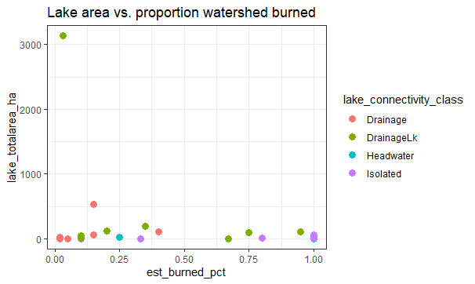
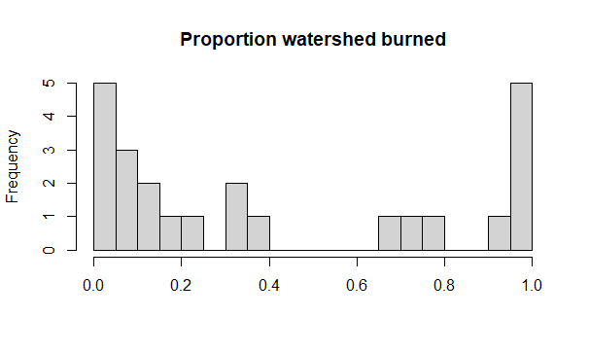
An ecologically important gradient is % watershed burned. I visually estimated this from the 9-13-21 fire map just to give us an idea.
Potentially have low and high subsets?

Slide 7
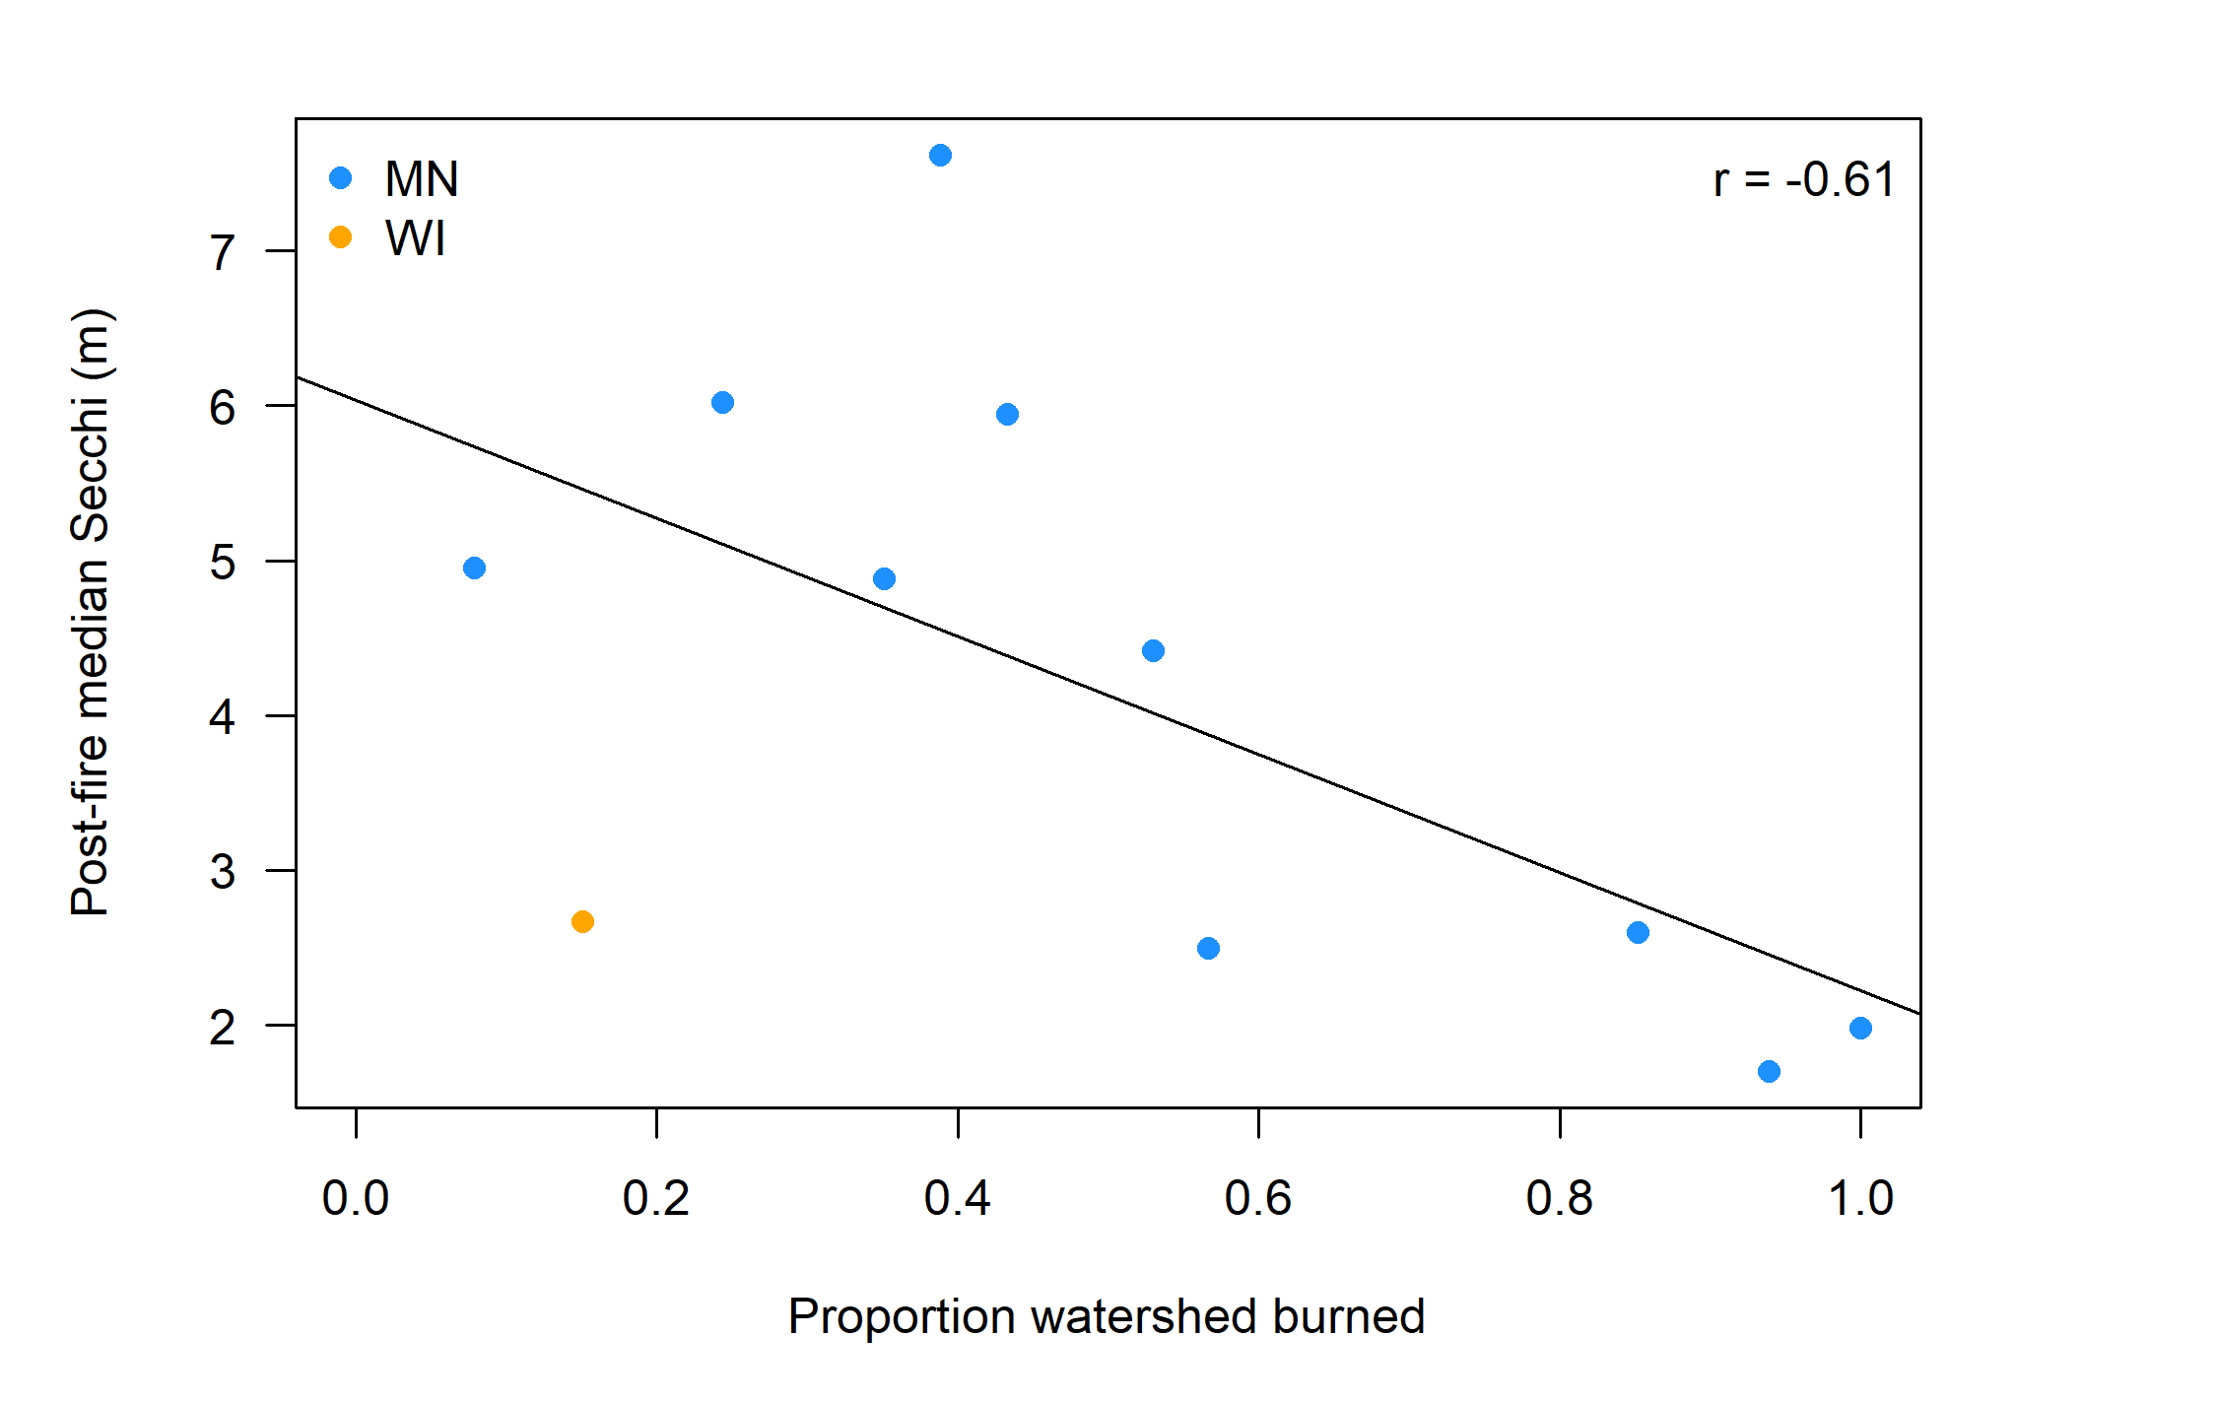
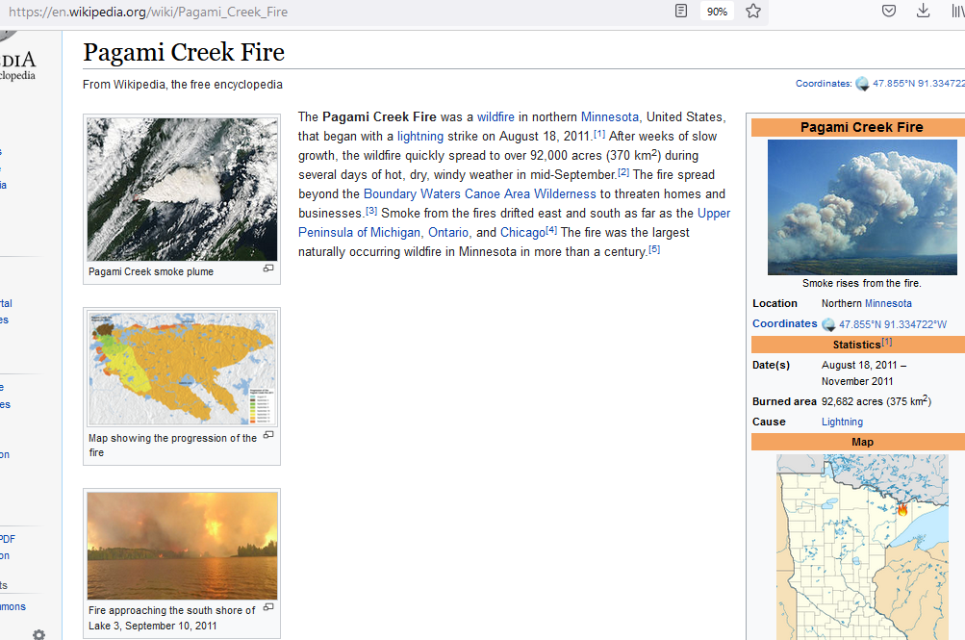
Why the % watershed burned gradient may matter – based on some LAGOSNE data (mostly from 2011 Pagami Creek fire)

Slide 8
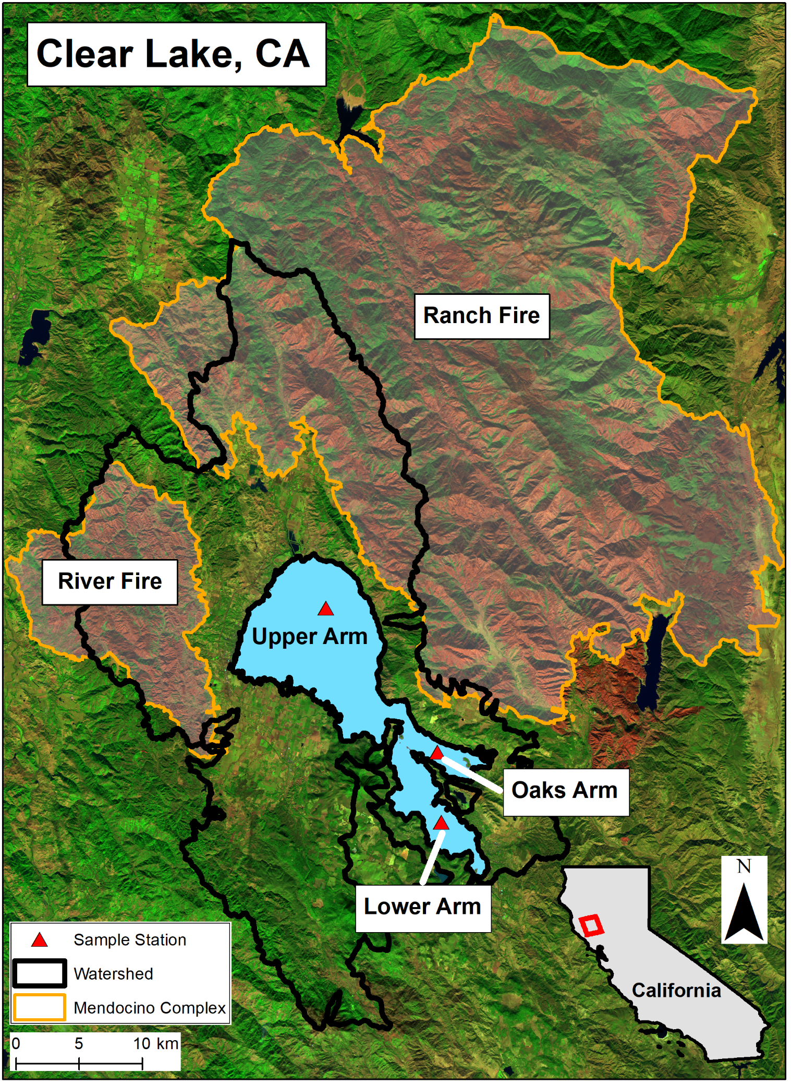
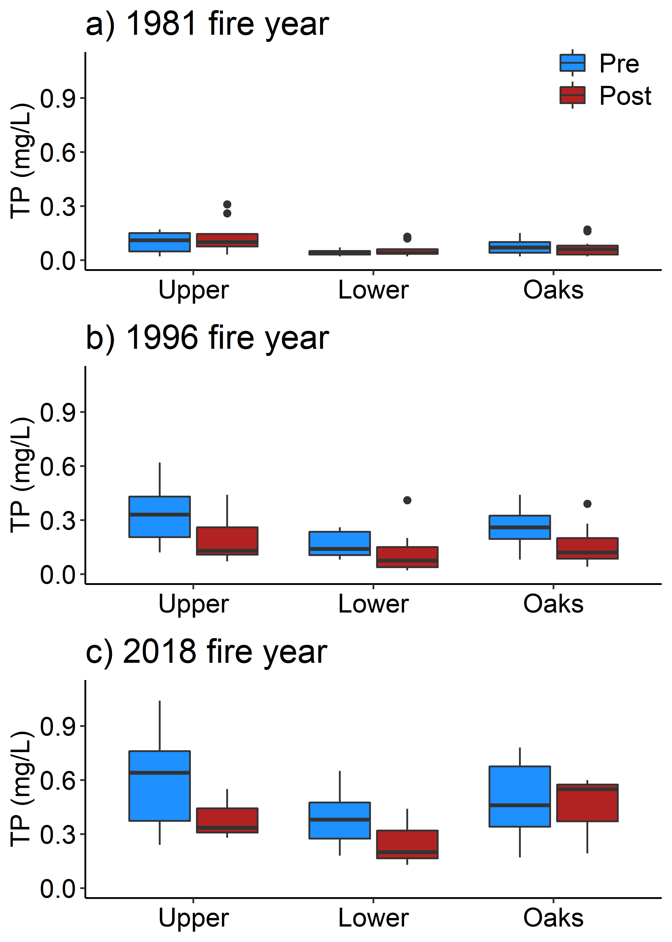
Why we need studies across ecologically diverse lakes/landscapes/fire regimes
DePalma-Dow, McCullough, Brentrup (revising). Turning up the heat: Using long-term data synthesis to reveal impacts of wildfire and climate change on phosphorus in a hyper-eutrophic natural lake
Notable findings
Fires have not affected lake TP
Long-term TP increase more associated with rising air temperatures and dissolved oxygen than precip or fires
Why this matters
Large hyper-eutrophic lake: not the same as small, boreal lake!
Mediterranean climate: runoff from summer fires doesn’t get washed into lake for months
12% watershed burned
2018 Mendocino Complex Fire
7% watershed burned
40% watershed burned
Pre= 3 years before fire, post=3 years after fire

Slide 9
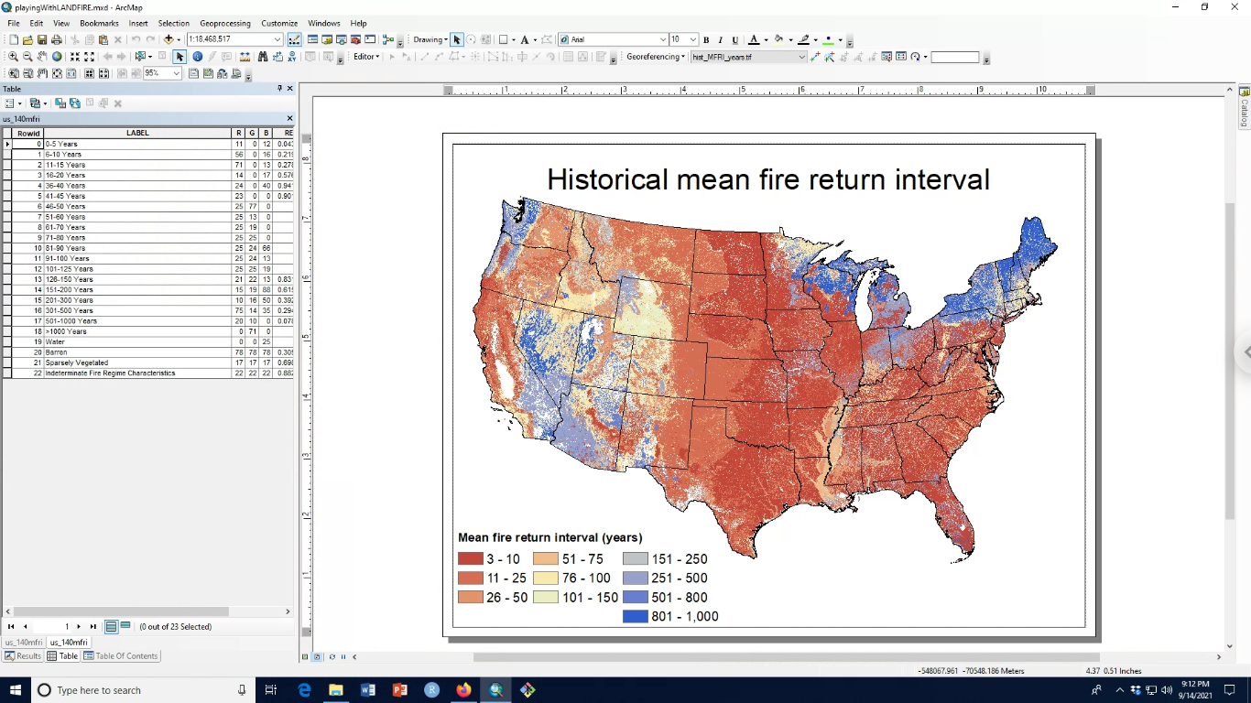
Grand vision
Study physical, chemical and biological responses of lakes to fires
Multiple study areas: ecologically diverse lakes, landscapes, fire regimes
Multiple years: understand post-fire lake recoveries (and mediating lake/landscape factors)
This short-term RAPID proposal could help launch future, larger-scale proposals
Possible study area
Where else??
Source: LANDFIRE
Historical: pre-Euro-American

Slide 10
Appendix

Slide 11
Source: LANDFIRE

Slide 12
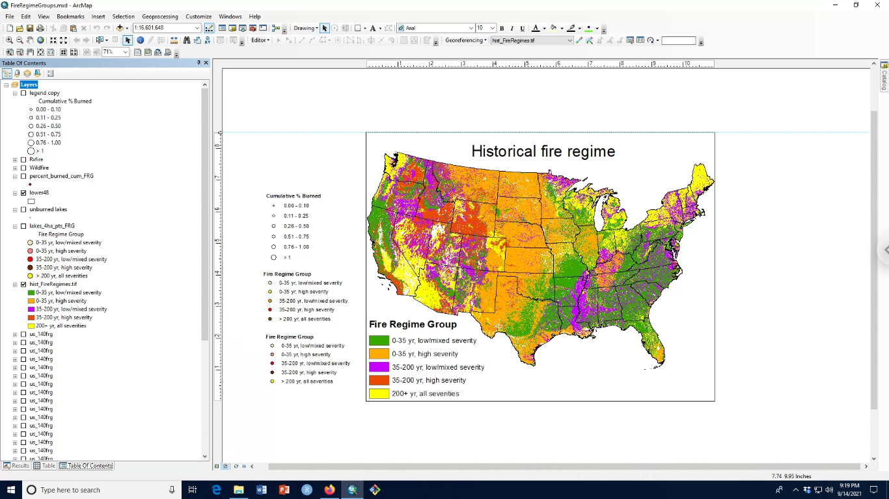
Landfire semantics
Low-severity: < 25% vegetation mortality
Mixed-severity: 25-75% veg mortality
High-severity: > 75% veg mortality
Historical = pre-Euro-American settlement
Source: LANDFIRE
Notes:
https://pubs.usgs.gov/of/2016/1010/ofr20161010.pdf
https://pubs.er.usgs.gov/publication/ofr20161010

Slide 13
Key knowledge gaps
Lake responses along key ecological gradients
Tier 1
Lake: size, depth
Fire: % watershed burned, % high severity, burn pattern
Tier 2
Lake shape, drainage ratio, isolated vs. other lake types
Landscape factors: topography, vegetation, soils, hydrology
Response variables:
Tier 1) Nutrients, chlorophyll-a, Secchi, TSS, DOC
Tier 2) Temperature, ions, mercury, biological community
Lake recoveries following fire
How quickly do lakes return to pre-fire conditions and what lake and landscape factors mediate these recoveries?

Slide 14
Historical fire regimes in NE Minnesota

Slide 15
The US Forest Service does publish fire polygons, but not until well after fires are extinguished
So, I manually georeferenced the 9-13-21 fire map to identify potentially impacted lakes/watersheds

Slide 16
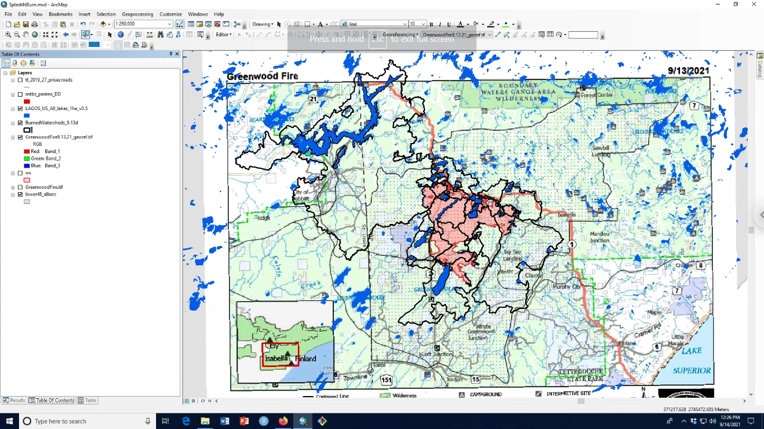
Messy messy! It also appears there were no large wildfires > 200 ha since 1984 in these watersheds

Slide 17
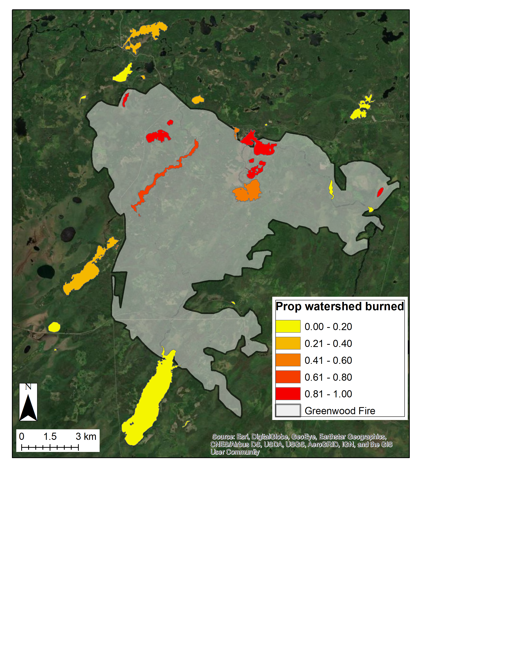
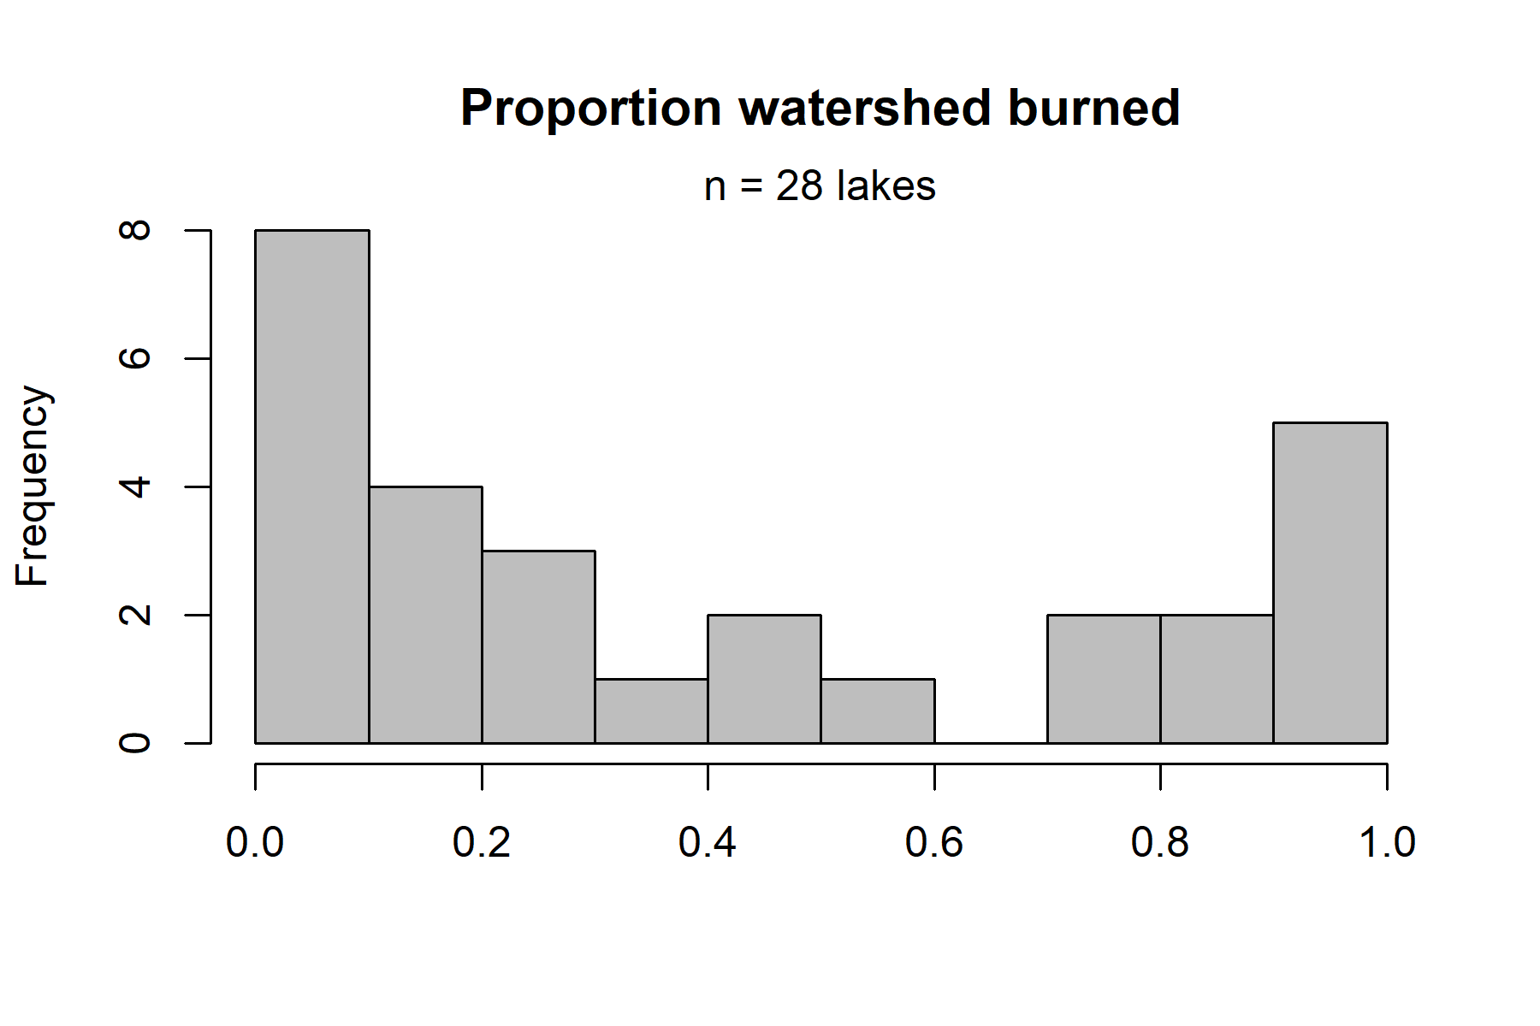
A)
B)

Slide 18
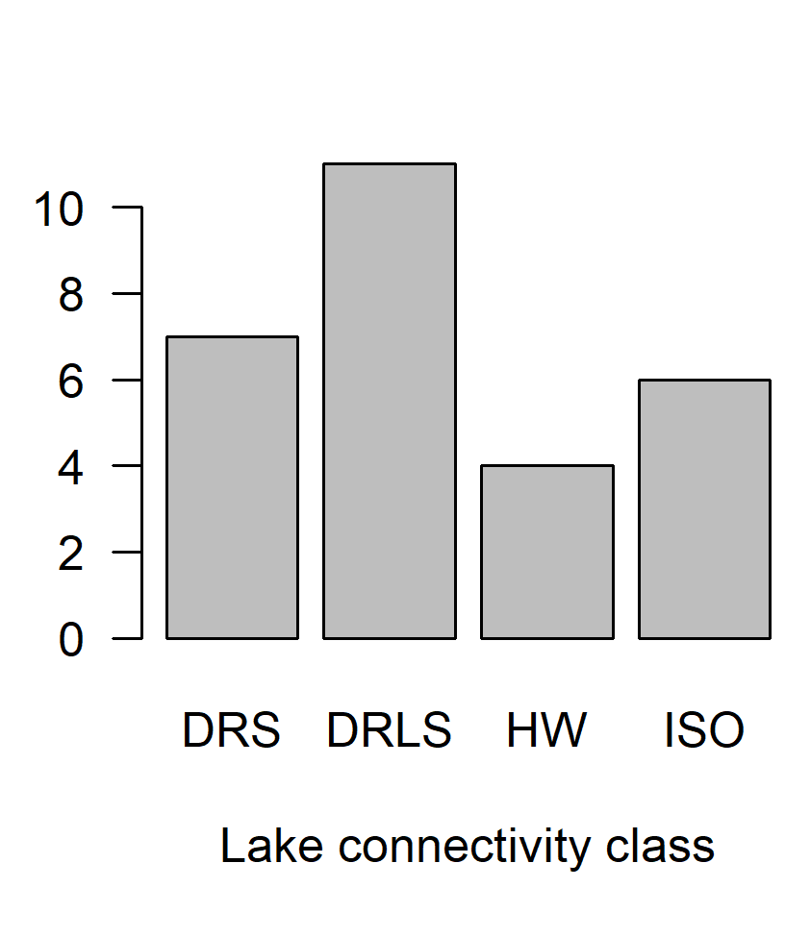
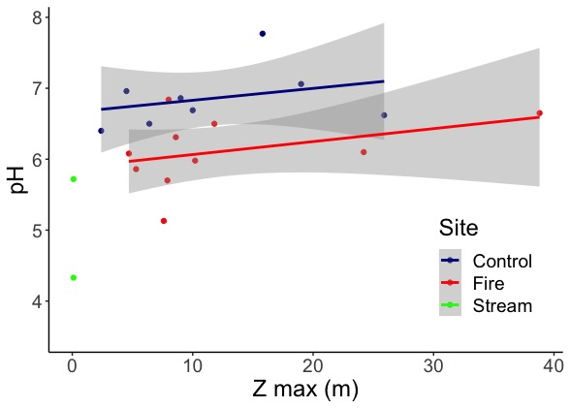
A)
B)
C)
Figure. Linear regressions of the surface water pH as a function of maximum depth (Z max) of 8 control lakes (blue), 11 lakes with a post-3 years wildfire in their watershed (red), and 2 in-coming lake tributaries (green) with a post-3 years wildfire in their watershed.

Slide 19
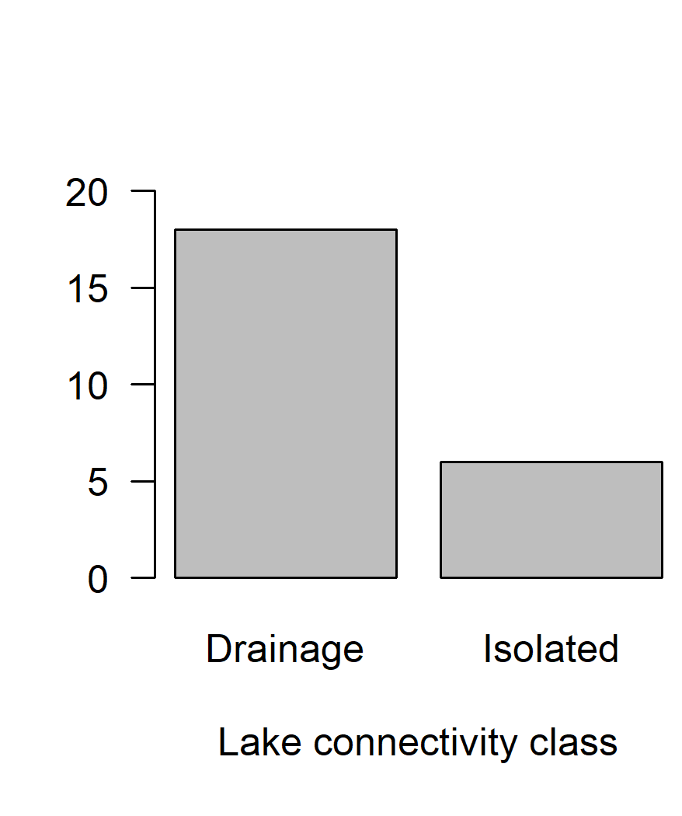
A)
B)
C)
Notes:
12-10-21 update

Slide 20
Figure. Linear regressions of the surface water pH as a function of maximum depth (Z max) of 8 control lakes (blue), 11 lakes with a post-3 years wildfire in their watershed (red), and 2 in-coming lake tributaries (green) with a post-3 years wildfire in their watershed.

